Slide 1
Topic 7 – Feature Engineering
Data Science for Business
Prof: Chris Volinsky
NYU Stern: Spring 2025

Slide 2
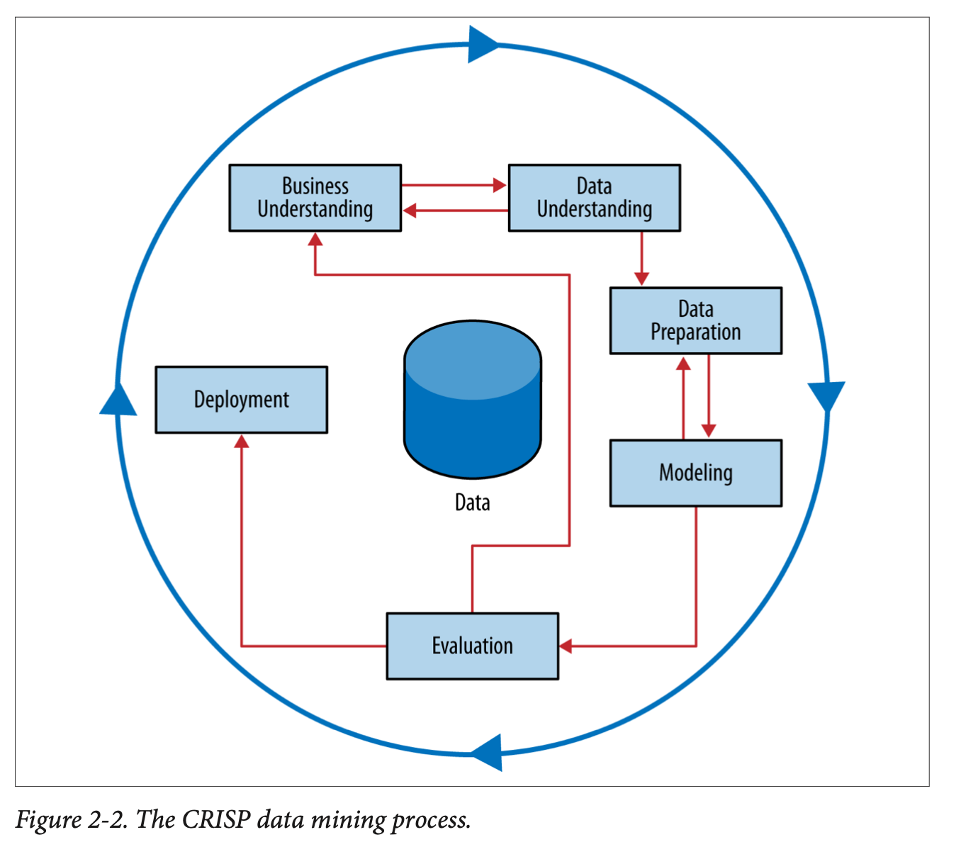
Feature Preparation
The features you get are not the only features you want to use
We talked about removing features for complexity control, but sometimes you might want to create new features
Feature Engineering

Slide 3
Feature Engineering
Sometimes features need to get created from multiple relational tables.
Name | Gender | Age | Income | Response (Target)
Alicent | F | 34 | Hi | 1
Bala | M | 21 | Mid | 0
Chantal | F | 29 | Lo | 1
…. | … | … | … | …
Task:
Predict whether a customer will
respond to a special offer, based on previous purchases
Given:
Customer attributes/demographics
Additional table with previous orders
Name | PurchaseDt | Type | Price | Coupon?
Alicent | 2023-10-02 | Digital | $9.99 | Yes
Alicent | 2023-09-11 | Digital | $19.99 | No
Alicent | 2023-08-11 | Book | $24.99 | No
Bala | 2023-11-01 | DVD | $24.99 | No
Bala | 2022-12-12 | Digital | $19.99 | No
Bala | 2024-01-02 | Book | $34.99 | Yes
Chantal | 2023-11-01 | DVD | $4.99 | Yes
Chantal | 2023-11-01 | Book | $4.99 | Yes
… | … | … |  | …
Notes:
Get class to do this? Ask them to create features. Purchases are over the last year of purchases
Training set is ABC from a pilot study…going to apply it to other people

Slide 4
Feature Engineering
Name | Gender | Age | Income | Resp
Alicent | F | 34 | Hi | 1
Bala | M | 21 | Mid | 0
Chantal | F | 29 | Lo | 1
… | … | … | … | …
Name | PurchaseDt | Type | Price | Coupon?
Alicent | 2023-10-02 | Digital | $9.99 | Yes
Alicent | 2023-09-11 | Digital | $19.99 | No
Alicent | 2023-08-11 | Book | $24.99 | No
Bala | 2023-11-01 | DVD | $24.99 | No
Bala | 2022-12-12 | Digital | $19.99 | No
Bala | 2024-01-02 | Book | $34.99 | Yes
Chantal | 2023-11-01 | DVD | $4.99 | Yes
Chantal | 2023-11-01 | Book | $4.99 | Yes
… | … | … |  | …
How do we turn this into a supervised learning scenario?
Name | X1 | X2 | X3 | X4 | X5 | Target
Alicent |  |  |  |  |  | 1
Bala |  |  |  |  |  | 0
Chantal |  |  |  |  |  | 1
Notes:
There are two ways to do this! Append demos to all purchases? Or summarize all purchases in feature engineering…follwoign slides show

Slide 5
Feature Engineering
Feature Engineering: what attributes can we create from the original data that get at the behavior we want and allow us to model with it?
Name | PurchaseDt | Type | Price | Coupon?
Alicent | 2023-10-02 | Digital | $9.99 | Yes
Alicent | 2023-09-11 | Digital | $19.99 | No
Alicent | 2023-08-11 | Book | $24.99 | No
Bala | 2023-11-01 | DVD | $24.99 | No
Bala | 2022-12-12 | Digital | $19.99 | No
Bala | 2024-01-02 | Book | $34.99 | Yes
Chantal | 2023-11-01 | DVD | $4.99 | Yes
Chantal | 2023-11-01 | Book | $4.99 | Yes
… | … | … |  | …
Name | Gend | Age | Inc | Sum Sales | Resp
Alicent | F | 34 | Hi | $54.97 | 1
Bala | M | 21 | Mid | $79.97 | 0
Chantal | F | 29 | Lo | $9.98 | 1
… | … | … | … |  | …
Notes:
What other attributes can we create? Number of sales, total sales, avg. sales, type of purchase, recency, max sale..

Slide 6
Feature Engineering
Naïve approach, just do a join:
Name |  |  |  | PurchaseDt | Type | Coupon? | Response
Alicent | F | 34 | Hi | 2023-10-02 | Digital | Yes | 1
Alicent | F | 34 | Hi | 2023-09-11 | Digital | No | 1
Alicent | F | 34 | Hi | 2023-08-11 | Book | No | 1
Bala | M | 21 | Mid | 2023-11-01 | DVD | No | 0
Bala | M | 21 | Mid | 2022-12-12 | Digital | No | 0
Bala | M | 21 | Mid | 2024-01-02 | Book | Yes | 1
Chantal | F | 29 | Lo | 2023-11-01 | DVD | Yes | 1
Chantal | F | 29 | Lo | 2023-11-01 | Book | Yes | 1
… | … | … | … | … | … | …
This could work, what might be the issues here?
Notes:
Now you are modelling PURCHASES instead of users, someone with many transactions is much more represented in the data.
Changes baseline. Also much more data
And you don’t get the advantage of adding more features…

Slide 7
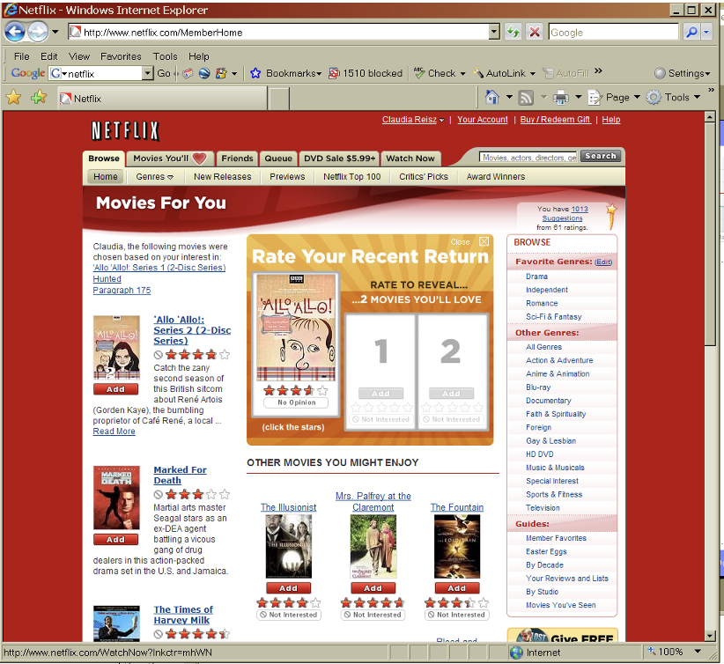
Netflix Prize Example
Notes:
This is what Netflix looked like in the early 2000s….

Slide 8
Netflix Prize Data
480k unique users
date | score | movie | user
2002-01-03 | 1 | 21 | 1
2002-04-04 | 5 | 213 | 1
2002-05-05 | 4 | 345 | 2
2002-05-05 | 4 | 123 | 2
2003-05-03 | 3 | 768 | 2
2003-10-10 | 5 | 76 | 3
2004-10-11 | 4 | 45 | 4
2004-10-11 | 1 | 568 | 5
2004-10-11 | 2 | 342 | 5
2004-12-12 | 2 | 234 | 5
2005-01-02 | 5 | 76 | 6
2005-01-31 | 4 | 56 | 6
… | … | … | ….
6 years of data
102M rows
Also:
Movie | Title
1 | Dinosaur Planet
2 | Midnight Run
… | …
17,700 unique movies
Notes:
What are the features? What is the target?
Build a model for each movie.
Want to predict if someone will like Jurassic Park
Need a matrix – training data of all the people who watched Jurassic Park
Target is rating of JP
What are the features?
What is the average number of movies rated per user?
What is the average number of users that rate a movie?
Want to create features for the users, how can we do that? Create 10 for users and 10 for movies…
Max rating user”. 17659 (is that real?) average is just over 200…
Max number of ratings movie? 240k – Miss Congeniality.
Number of movies rated
Average of movies rated
Max score
Min score
Average score
SD score
How did they rate similar movies to Jurassic park how did they rate movies with same director (if any)
% of ratings that are 5
Day span of ratings
Max ratings on a single day
Most recent rating (how many days ago)
DATE ISNT USEFUL!
Movies
How many people rated it?
What is the span of time?
Genre
Sub-genre
director

Slide 9
Feature Engineering
Some things you may want to do to features before modelling:
Covert Numeric Variable to categorical
define highest 10% or H/M/L categories
Binning of target or attribute to account for long tail
Dates: Extract year/month/hour from date as separate features
Calculate useful features from dates (tenure, duration, last seen)
Combine columns
Mean, max, min, or total might be more relevant than individuals
Create aggregates
Get Creative! It can make a huge difference in predictive performance..

